Slide 1
Edge AI Wildlife Detection and Monitoring Software
ARTIFICIAL INTELLIGENCE PROJECT (DA1)
ABHIRAM R
24BRS1373

Slide 2







Problem Identification & Motivation
Wildlife monitoring is critical for conservation, yet current approaches face significant challenges that limit their effectiveness in protecting endangered species and ecosystems.
Habitat Destruction
Illegal Poaching
Human–Wildlife Conflict
Manual Monitoring Challenges
Cloud Dependency
Need for Real-Time Monitoring
"Wildlife populations have declined by approximately 73% since 1970 (WWF Living Planet Report 2024)."

Slide 3

Literature Survey & Research Gap
The following table summarizes 15 research papers reviewed in this study, highlighting their methods, contributions, and limitations.
Year
Method
Contribution
Limitation
2023
Faster R-CNN
High accuracy detection on large datasets
High computational cost
2022
YOLOv5
Real-time detection with good accuracy
Limited edge deployment
2022
EfficientDet
Scalable object detection
Slow inference on edge devices
2021
ResNet-50 + FPN
Feature pyramid networks for multi-scale detection
Memory intensive
2021
MobileNetV2
Lightweight CNN for mobile deployment
Lower accuracy on small objects
2020
SSD
Single-shot detection for speed
Poor performance on small animals
2020
RetinaNet
Focal loss for class imbalance
High latency
2019
YOLOv3
Multi-scale prediction
Not optimized for edge
2019
Mask R-CNN
Instance segmentation for wildlife
Computationally expensive
2018
VGG-16
Deep feature extraction
Very high parameter count
2023
YOLOv7
Improved anchor-free detection
Limited low-light performance
2022
Swin Transformer
Attention-based vision transformer
Not suitable for edge devices
2021
NanoDet
Ultra-lightweight detection
Lower mAP on complex scenes
2020
CenterNet
Anchor-free keypoint detection
Sensitive to occlusion
2019
CornerNet
Corner-based object detection
Slow training convergence
Research Gaps Identified
"Our proposed software addresses these limitations."
High computational complexity
Limited edge deployment
Environmental challenges
Class imbalance
Lack of intelligent decision support

Slide 4






Problem Statement & Objectives
Problem Statement: Develop an Edge AI-based wildlife detection software capable of performing real-time animal detection on low-power edge devices while maintaining high detection accuracy and low latency.
Objectives
Real-Time Wildlife Detection
Edge AI Deployment
Lightweight Deep Learning Model
Automated Alerts
Monitoring Dashboard
Conservation Support

Slide 5
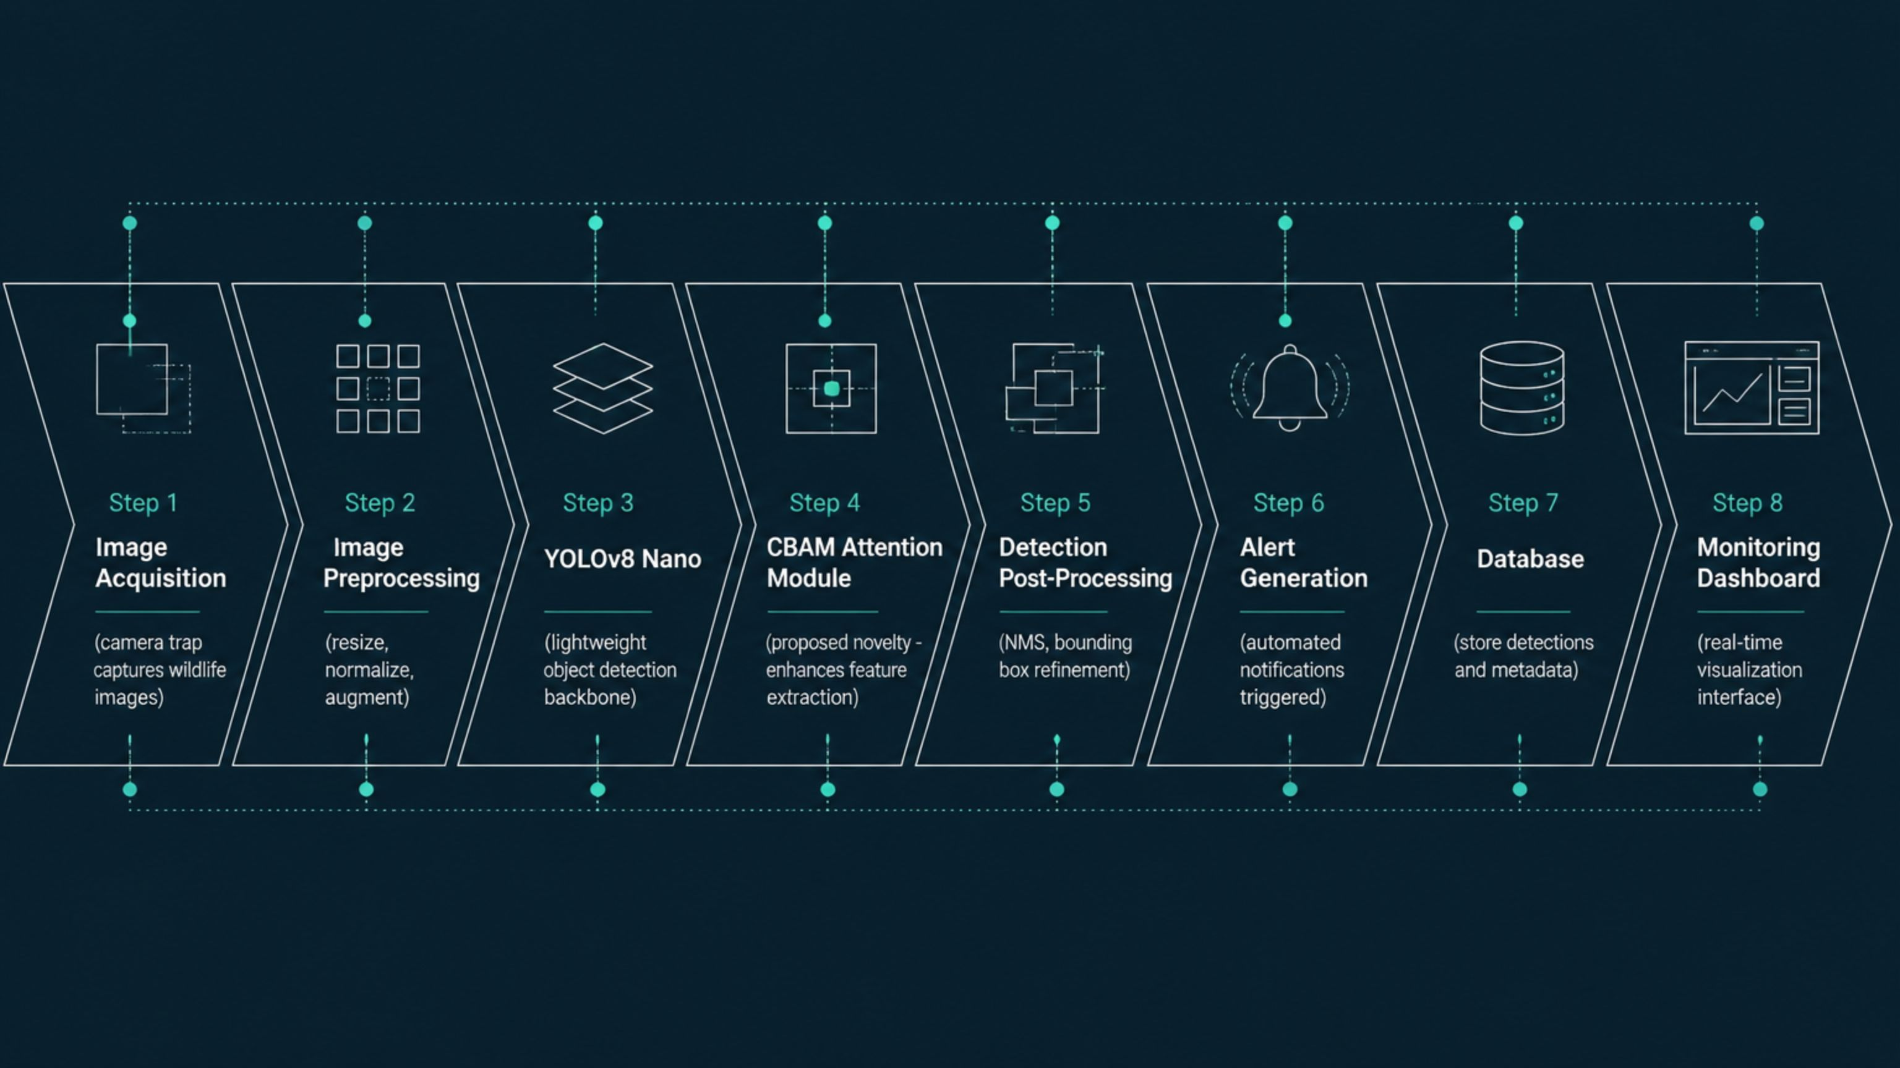
Proposed Software Architecture
The proposed architecture integrates a novel CBAM Attention Module within the YOLOv8 Nano backbone to enhance feature extraction while maintaining low computational overhead for edge deployment.

Slide 6
AI Model & Experimental Setup
Model
Software
YOLOv8 Nano + CBAM Attention Module
Python
PyTorch
OpenCV
TensorRT
Datasets
Snapshot Serengeti
iWildCam
Wildlife Insights
Hardware
Dataset Split
NVIDIA RTX 3060
Jetson Nano
Training – 70%
Validation – 15%
Testing – 15%
Evaluation Metrics
Precision
Recall
F1-Score
mAP@0.5
FPS
Latency

Slide 7






Expected Results & Applications
Expected Results
>93%
>92%
>94%
Precision
Recall
mAP
<100ms
>20
Inference Time
FPS
Low Power Consumption
Applications
Wildlife Conservation
National Parks
Anti-Poaching Surveillance
Forest Monitoring
Biodiversity Assessment
Human–Wildlife Conflict Prevention

Slide 8
Feasibility Study
Hardware
Risks
Jetson Nano
Raspberry Pi 5
RTX 3060
Low-light images
Occlusion
Class imbalance
Software
Mitigation
Python
PyTorch
YOLOv8
TensorRT
Data augmentation
Attention mechanism
Model optimization
Dataset
250,000+ wildlife images
Estimated Cost
Low-cost edge deployment

Slide 9
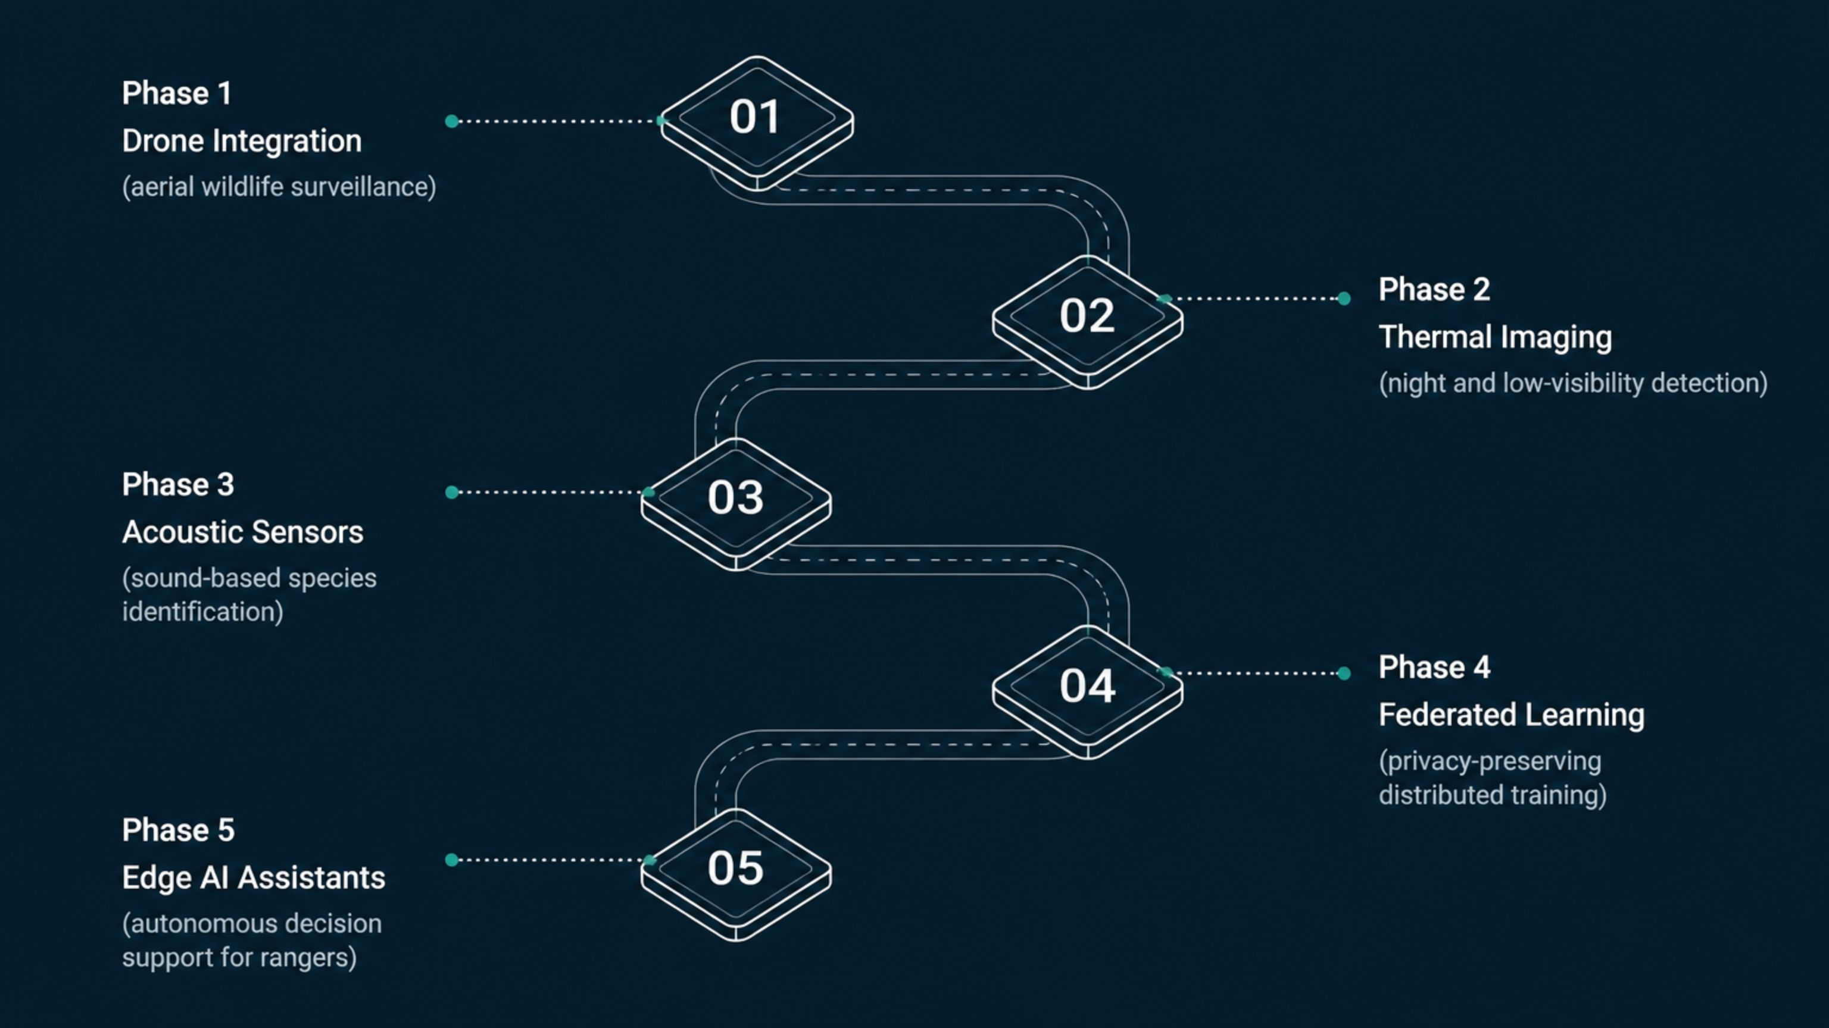
Conclusion & Future Scope
Conclusion
Future Scope
Lightweight Edge AI architecture
Real-time wildlife monitoring
Low latency
High accuracy
Cost-effective deployment
Drone integration
Thermal imaging
Acoustic sensors
Federated learning
Edge AI assistants

Slide 10
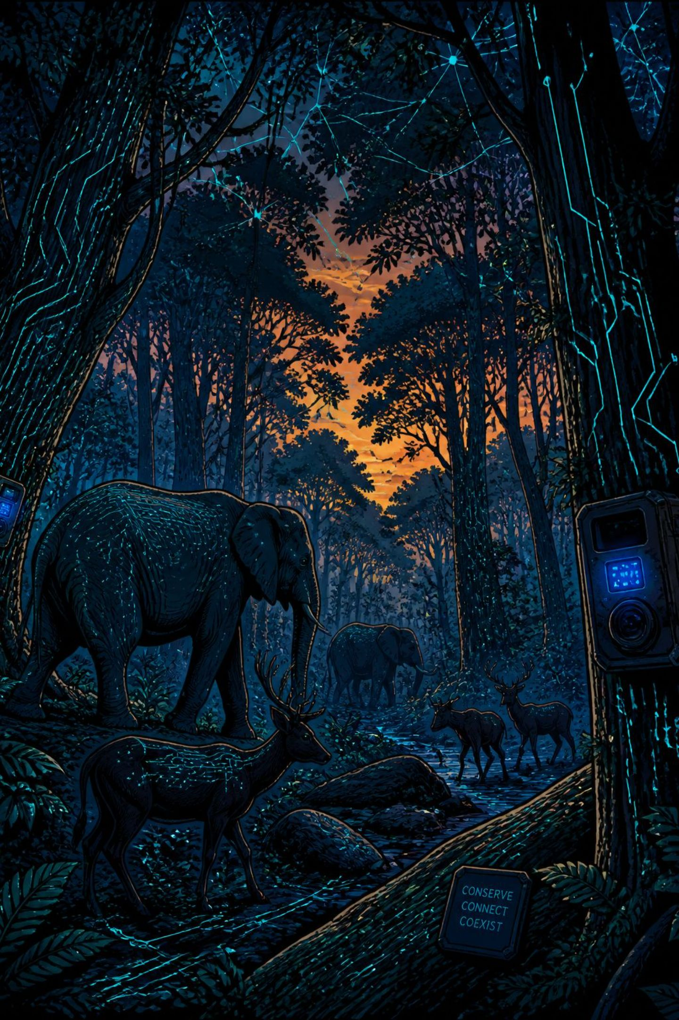
Thank You
Questions & Discussion
Project
Course
Edge AI Wildlife Detection and Monitoring Software
Design and Analysis Project (DA1)
Theme
AI + Wildlife Conservation

